Slide 1
Continuous Distributed Representation of Biological Sequences for Deep Proteomics and Genomics
Ehsaneddin et. al.
University of California, Berkeley, California

Slide 2
ABSTRACT INTRODUCTION Distributed Representation Protein Family Classification Disordered Proteins METHODS Protein-Space Construction Protein-Space Analysis Protein Family Classification Visualization and Classification of Disordered Proteins RESULTS Protein-Space Analysis Protein Family Classification Disordered Proteins Visualization and Classification CONCLUSION

Slide 3
ABSTRACT
New representation and feature extraction method for biological sequences
protein-vectors (ProtVec) for proteins
gene-vectors (GeneVec) for gene sequences
Applications
family classification
protein visualization
structure prediction
disordered protein identification
and protein-protein interaction prediction
Method
Artificial neural network approaches →single dense n-dimensional vector

Slide 4
ABSTRACT
Results
324,018 protein sequences from Swiss-Prot
7,027 protein families
accuracy of 93% ± 0.06%
Two databases of disordered sequences
DisProt
100.0% accuracy
FG-Nups
99.8% accuracy
Highlights
Model needs to be trained only once and can then be applied to extract a comprehensive set of information regarding proteins of interest
This representation can be considered as pre-training for various applications
Notes:
database featuring the disordered regions of nucleoporins rich with phenylalanine-glycine repeats (FG-Nups)

Slide 5
INTRODUCTION
The analogy of natural language and biological sequences
Feature extraction is always important to classification model’s performance
Notes:
database featuring the disordered regions of nucleoporins rich with phenylalanine-glycine repeats (

Slide 6
INTRODUCTION Distributed representation
Most successful approaches in machine learning
Encoding and storing information about an item within a system through establishing its interactions with other members
Skip-gram model

Slide 7
INTRODUCTION Protein Family Classification
A protein family
is a set of proteins that are evolutionarily related
similar structures or functions
The large gap
No. of known sequences vs No. of known functional information
In Pfam (Protein Family Database), a family can be classified as a “family”, “domain”, “repeat”, or “motif”

Slide 8
INTRODUCTION Disorder proteins
Proteins can be fully or partially unstructured
i.e. lacking a secondary or ordered tertiary three-dimensional structure
Disordered proteins are considered to be an important class of proteins
This work studied on proteins from:
DisProt database
Experimentally identified
694 proteins presenting 1539 disordered, and 95 ordered regions
FG-Nups database
Mostly computationally identified
10 sequences out of 1,138 disordered sequences

Slide 9
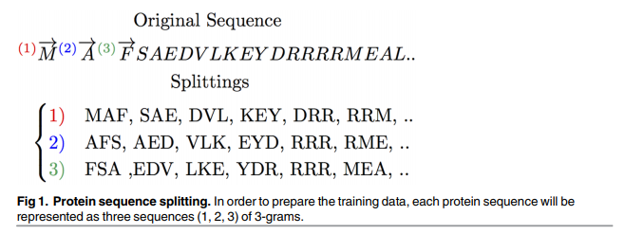
METHOD Protein-Space Construction
Utilize 546,790 manually annotated and reviewed sequences from Swiss-Prot
Generate 3 lists of shifted non-overlapping words
546,790 x 3 = = 1,640,370 sequences of 3-grams
Use Skip-gram neural network to generate a general purpose distributed representation of sequences
Vector size = 100, context size = 25

Slide 10
METHOD Protein-Space Analysis
SNE technique
Mass, volume, polarity, hydrophobicity, charge, and van der Waals volume properties were analyzed

Slide 11
METHOD Protein Family Classification
Classification task on protein families
324,018 protein sequences in Swiss-Prot is extracted from the Protein Family (Pfam) database
7,027 distinct families for Swiss-Prot
Each sequence is represented as the summation of the vector representation of overlapping 3-grams
vector of size 100
For each family type, the same number of instances from Swiss-Prot are selected randomly to form the negative examples
Support vector machine classifiers are used
10 fold cross validation

Slide 12
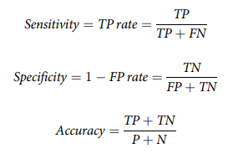
METHOD Protein Family Classification

Slide 13
METHOD Visualization and Classification of Disordered Proteins
DisProt database (694 sequences)
DisProt Release 6.02 presenting 1539 disordered and 95 ordered
FG-Nups dataset (1,138 sequences)
Compared with two random sets of 1,138 structured proteins from Protein Data Bank (PDB)

Slide 14
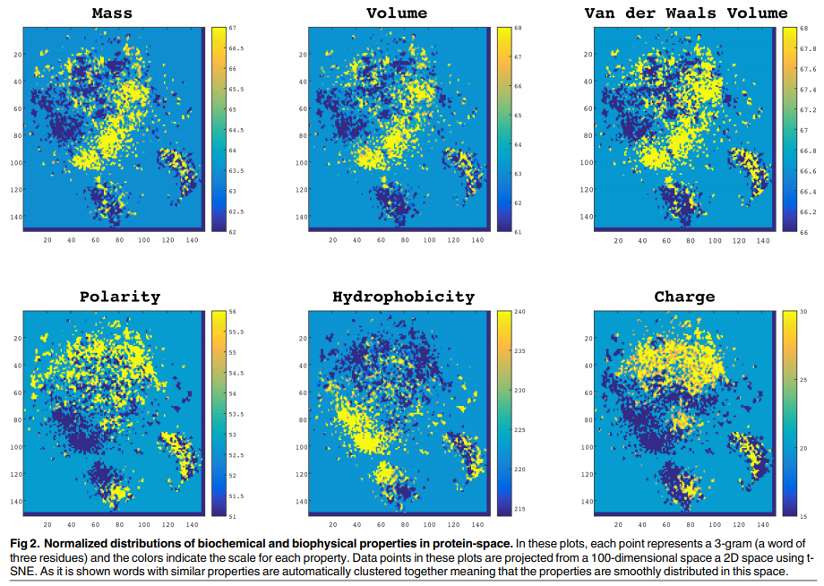
RESULTS Protein-Space Analysis

Slide 15
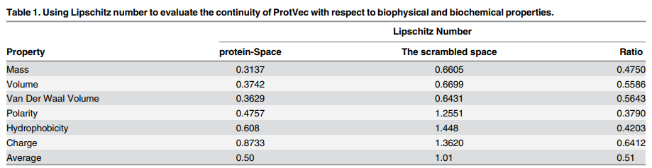
RESULTS Protein-Space Analysis

Slide 16
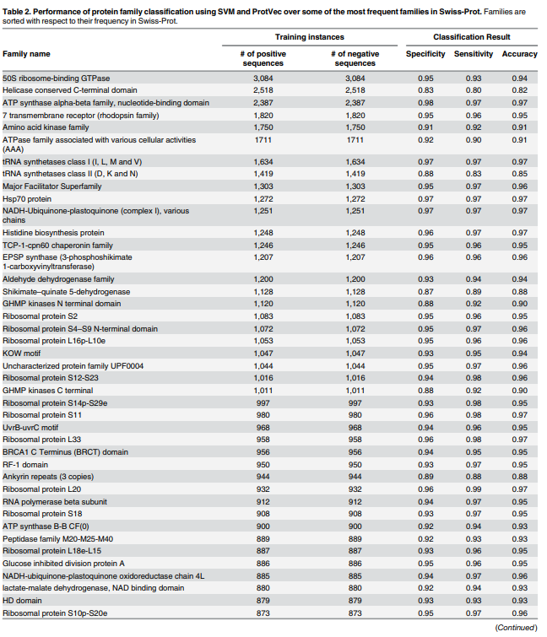
RESULTS Protein Family Classification
weighted average accuracy of 93 ± 0.06%
more reliable result than the existing methods

Slide 17
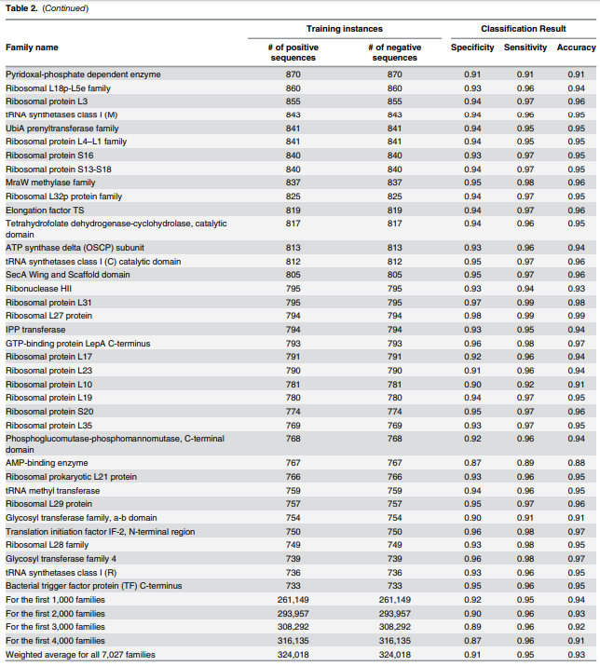
RESULTS Protein Family Classification

Slide 18
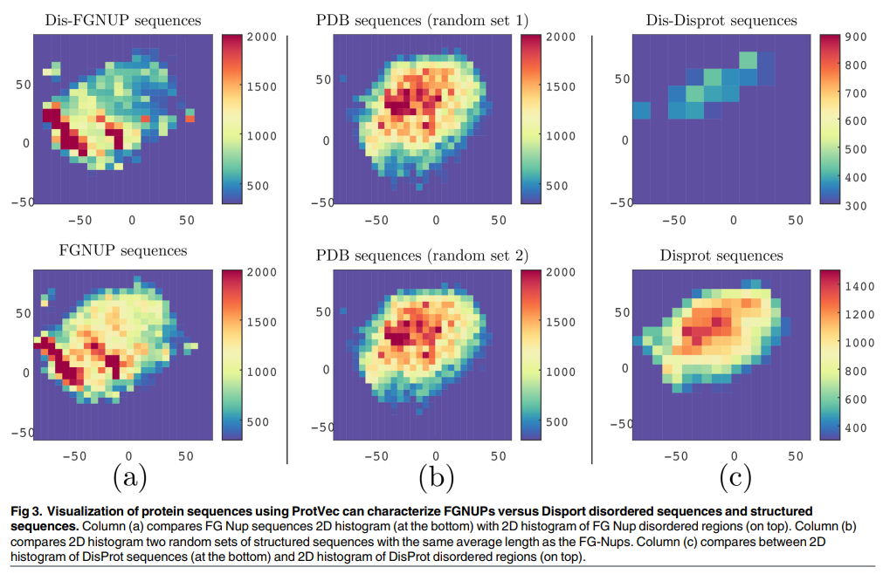
METHOD Disordered Proteins Visualization and Classification
Visualized by dimensionality of the protein-space using SNE and generated the 2D histogram of all overlapping 3-grams occurring in each dataset

Slide 19
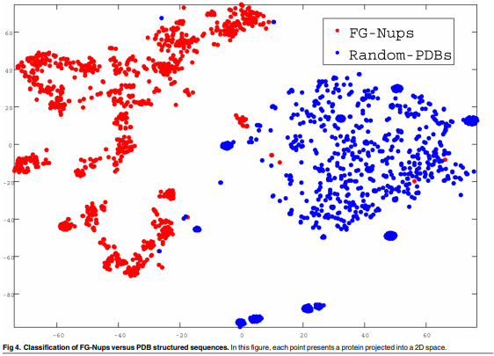
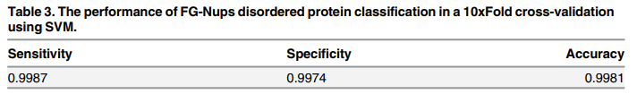
METHOD Disordered Proteins Visualization and Classification
Quantitatively evaluated how ProtVec can be used to distinguish between FG-Nups versus typical PDB sequences using a support vector machine binary classification

Slide 20
CONCLUSIONS
ProtVec can be used
as an informative and dense representation for biological sequences in protein family classification, and obtained an average family classification accuracy of 93%.
to identify disordered sequences with an accuracy of nearly 100%
Data availability
http://llp.berkeley.edu
http://dx. doi.org/10.7910/DVN/JMFHTN
Notes:
database featuring the disordered regions of nucleoporins rich with phenylalanine-glycine repeats (FG-Nups)

